Slide 1
Chapter Fifteen
Firm Supply
厂商供给

Slide 2
Structure
Market environments
Market demand for a competitive firm
Short-run supply decision
  Upward sloping MC curve
  Shut-down condition
Long-run supply decision
Comparing long-run and short-run decisions
Producer’s surplus and profits

Slide 3
Firm Supply
How does a firm decide how much product to supply? This depends upon the firm’s
  technology
  market environment
  goals
  competitors’ behaviors

Slide 4
Market Environments
Are there many other firms, or just a few?
Do other firms’ decisions affect our firm’s payoffs?
Is trading anonymous, in a market? Or are trades arranged with separate buyers by middlemen?

Slide 5
Market Environments
Monopoly (垄断）: Just one seller that determines the quantity supplied and the market-clearing price.
Oligopoly （寡头垄断）: A few firms, the decisions of each influencing the payoffs of the others.

Slide 6
Market Environments
Dominant Firm: Many firms, but one much larger than the rest. The large firm’s decisions affect the payoffs of each small firm. Decisions by any one small firm do not noticeably affect the payoffs of any other firm.

Slide 7
Market Environments
Monopolistic Competition （垄断竞争）: Many firms each making a slightly different product. Each firm’s output level is small relative to the total.
Pure Competition: Many firms, all making the same product. Each firm’s output level is small relative to the total.

Slide 8
Market Environments
Later chapters examine monopoly, oligopoly, and the dominant firm.
This chapter explores only pure competition.

Slide 9
Pure Competition
A firm in a perfectly competitive market knows it has no influence over the market price for its product. The firm is a market price-taker.
The firm is free to vary its own price.

Slide 10
Pure Competition
If the firm sets its own price above the market price then the quantity demanded from the firm is zero.
If the firm sets its own price below the market price then the quantity demanded from the firm is the entire market quantity-demanded.

Slide 11
Pure Competition
So what is the demand curve faced by the individual firm?

Slide 12
Pure Competition
$/output unit
Market Supply
p^{e}
Market Demand
Y

Slide 13
Pure Competition
$/output unit
Market Supply
p’
p^{e}
At a price of p’, zero is demanded from the firm.
Market Demand
y

Slide 14
Pure Competition
$/output unit
Market Supply
p’
p^{e}
At a price of p’, zero is demanded from the firm.
p”
Market Demand
y
At a price of p” the firm faces the entire market demand.

Slide 15
Pure Competition
So the demand curve faced by the individual firm is ...

Slide 16
Pure Competition
$/output unit
Market Supply
p’
p^{e}
At a price of p’, zero is demanded from the firm.
p”
Market Demand
y
At a price of p” the firm faces the entire market demand.

Slide 17
Pure Competition
$/output unit
p’
p^{e}
p”
Market Demand
Y

Slide 18
Smallness
What does it mean to say that an individual firm is “small relative to the industry”?

Slide 19
Smallness
$/output unit
Firm’s MC
Firm’s demand
curve
p^{e}
y
The individual firm’s technology causes it
always to supply only a small part of the
total quantity demanded at the market price.

Slide 20
The Firm’s Short-Run Supply Decision
Each firm is a profit-maximizer and in a short-run.
Q: How does each firm choose its output level?

Slide 21
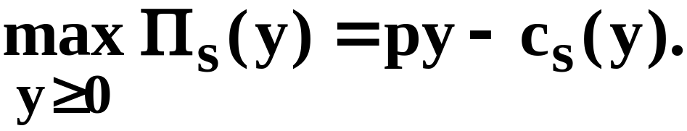
The Firm’s Short-Run Supply Decision
Each firm is a profit-maximizer and in a short-run.
Q: How does each firm choose its output level?
A: By solving

Slide 22
The Firm’s Short-Run Supply Decision
What can the solution y_{s}* look like?

Slide 23
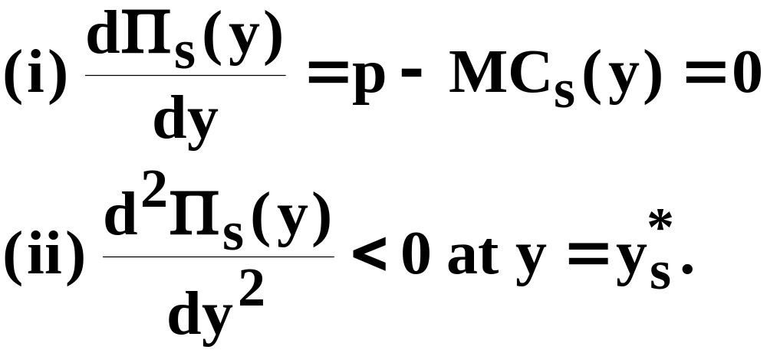
The Firm’s Short-Run Supply Decision
What can the solution y_{s}* look like?
(a) y_{s}* > 0:
Π(y)
y_{s}*
y

Slide 24
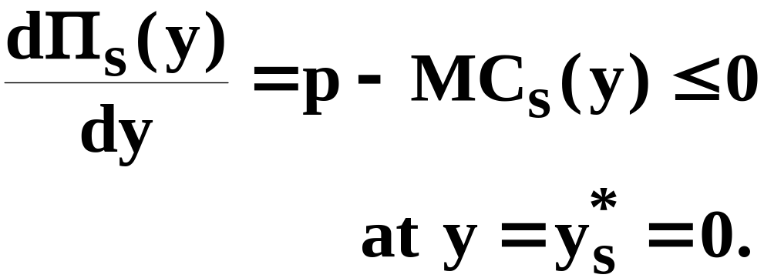
The Firm’s Short-Run Supply Decision
What can the solution y* look like?
(b) y_{s}* = 0:
Π(y)
y
y_{s}* = 0

Slide 25
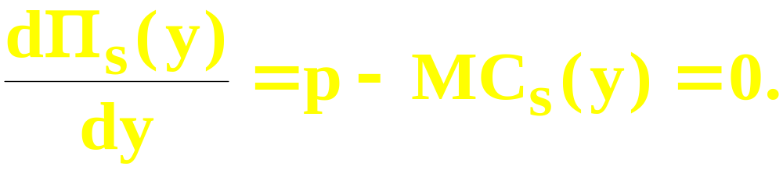
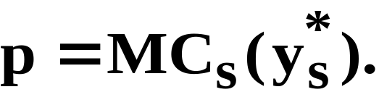
The Firm’s Short-Run Supply Decision
For the interior case of y_{s}* > 0, the first-
order maximum profit condition is
That is,
So at a profit maximum with y_{s}* > 0, the
market price p equals the marginal
cost of production at y = y_{s}*.

Slide 26
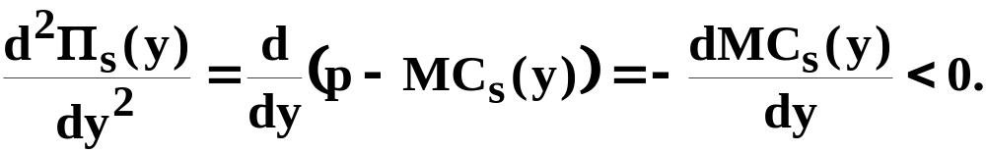
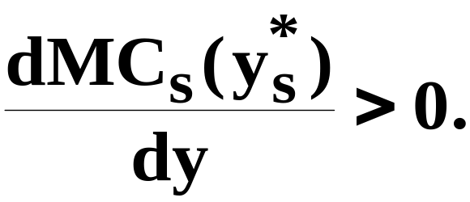
The Firm’s Short-Run Supply Decision
For the interior case of y_{s}* > 0, the second-
order maximum profit condition is
That is,
So at a profit maximum with y_{s}* > 0, the
firm’s MC curve must be upward-sloping.

Slide 27
The Firm’s Short-Run Supply Decision
$/output unit
p^{e}
MC_{s}(y)
y’
y_{s}*
y

Slide 28
The Firm’s Short-Run Supply Decision
$/output unit
At y = y_{s}*, p = MC and MC
slopes upwards. y = y_{s}* is
profit-maximizing.
p^{e}
MC_{s}(y)
y’
y_{s}*
y

Slide 29
The Firm’s Short-Run Supply Decision
$/output unit
At y = y_{s}*, p = MC and MC
slopes upwards. y = y_{s}* is
profit-maximizing.
p^{e}
MC_{s}(y)
y’
y_{s}*
y
At y = y’, p = MC and MC slopes downwards.
y = y’ is profit-minimizing.

Slide 30
The Firm’s Short-Run Supply Decision
$/output unit
At y = y_{s}*, p = MC and MC
slopes upwards. y = y_{s}* is
profit-maximizing.
So a profit-max.
supply level
can lie only on
the upwards
sloping part
of the firm’s
MC curve.
p^{e}
MC_{s}(y)
y’
y_{s}*
y

Slide 31
The Firm’s Short-Run Shut-Down Condition
But not every point on the upward-sloping part of the firm’s MC curve represents a profit-maximum.

Slide 32
The Firm’s Short-Run Shut-Down Condition
But not every point on the upward-sloping part of the firm’s MC curve represents a profit-maximum.
The firm’s profit function is
If the firm chooses y = 0 then its profit is

Slide 33
The Firm’s Short-Run Shut-Down Condition
So the firm will choose an output level y > 0 only if

Slide 34
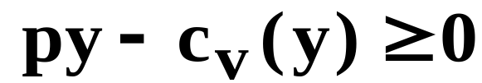
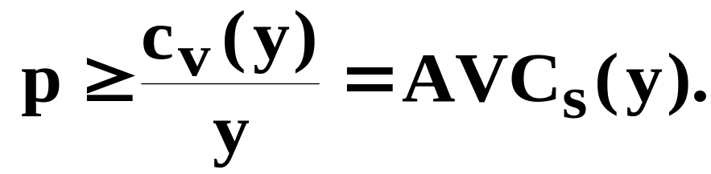
The Firm’s Short-Run Shut-Down Condition
So the firm will choose an output level y > 0 only if
I.e., only if
Equivalently, only if

Slide 35
The Firm’s Short-Run Shut-Down Condition
$/output unit
MC_{s}(y)
AC_{s}(y)
AVC_{s}(y)
y

Slide 36
The Firm’s Short-Run Shut-Down Condition
$/output unit
MC_{s}(y)
AC_{s}(y)
AVC_{s}(y)
y

Slide 37
The Firm’s Short-Run Shut-Down Condition
$/output unit
p > AVC_{s}(y)
MC_{s}(y)
AC_{s}(y)
AVC_{s}(y)
y

Slide 38
The Firm’s Short-Run Shut-Down Condition
$/output unit
p > AVC_{s}(y) y_{s}* > 0.
MC_{s}(y)
AC_{s}(y)
AVC_{s}(y)
y

Slide 39
The Firm’s Short-Run Supply Decision
$/output unit
p > AVC_{s}(y) y_{s}* > 0.
MC_{s}(y)
AC_{s}(y)
AVC_{s}(y)
y
p < AVC_{s}(y) y_{s}* = 0.

Slide 40
The Firm’s Short-Run Supply Decision
$/output unit
p > AVC_{s}(y) y_{s}* > 0.
MC_{s}(y)
AC_{s}(y)
AVC_{s}(y)
The firm’s short-run
supply curve
y
p < AVC_{s}(y) y_{s}* = 0.

Slide 41
The Firm’s Short-Run Supply Decision
$/output unit
Shutdown
point
MC_{s}(y)
AC_{s}(y)
AVC_{s}(y)
The firm’s short-run
supply curve
y

Slide 42
The Firm’s Short-Run Supply Decision
Shut-down is not the same as exit.
Shutting-down means producing no output (but the firm is still in the industry and suffers its fixed cost).
Exiting means leaving the industry, which the firm can do only in the long-run.

Slide 43
The Firm’s Long-Run Supply Decision
The long-run is the circumstance in which the firm can choose amongst all of its short-run circumstances.
How does the firm’s long-run supply decision compare to its short-run supply decisions?

Slide 44

The Firm’s Long-Run Supply Decision
A competitive firm’s long-run profit function is
The long-run cost c(y) of producing y units of output consists only of variable costs since all inputs are variable in the long-run.

Slide 45
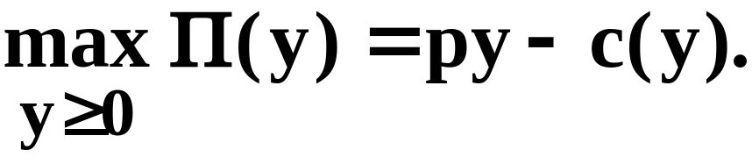
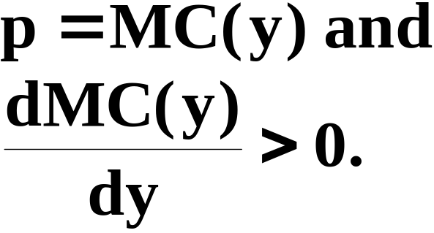
The Firm’s Long-Run Supply Decision
The firm’s long-run supply level decision is to
The 1st and 2nd-order maximization conditions are, for y* > 0,

Slide 46
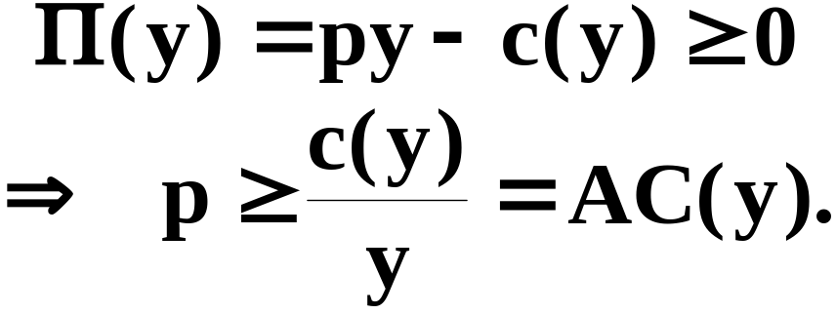
The Firm’s Long-Run Supply Decision
Additionally, the firm’s economic profit level must not be negative since then the firm would exit the industry. So,

Slide 47
The Firm’s Long-Run Supply Decision
$/output unit
MC(y)
AC(y)
y

Slide 48
The Firm’s Long-Run Supply Decision
$/output unit
MC(y)
p > AC(y)
AC(y)
y

Slide 49
The Firm’s Long-Run Supply Decision
$/output unit
MC(y)
p > AC(y)
AC(y)
y

Slide 50
The Firm’s Long-Run Supply Decision
$/output unit
MC(y)
The firm’s long-run
supply curve
AC(y)
y

Slide 51
Long-Run Constant Average Costs
$/output unit
LMC=long-run supply
C_{min}
Y

Slide 52
The Firm’s Long-Run Supply Decision
How is the firm’s long-run supply curve related to all of its short-run supply curves?

Slide 53
The Firm’s Long & Short-Run Supply Decisions
$/output unit
AC_{s}(y)
MC(y)
MC_{s}(y)
AC(y)
y

Slide 54
The Firm’s Long & Short-Run Supply Decisions
$/output unit
AC_{s}(y)
MC(y)
MC_{s}(y)
AC(y)
p’
y_{s}*
y*
y
y_{s}* is profit-maximizing in this short-run.

Slide 55
The Firm’s Long & Short-Run Supply Decisions
$/output unit
AC_{s}(y)
MC(y)
MC_{s}(y)
AC(y)
p’
Π_{s}
y_{s}*
y*
y
y_{s}* is profit-maximizing in this short-run.

Slide 56
The Firm’s Long & Short-Run Supply Decisions
$/output unit
AC_{s}(y)
MC(y)
MC_{s}(y)
AC(y)
p’
Π_{s}
Π
y_{s}*
y*
y
The firm can increase profit by increasing
x₂ and producing y* output units.

Slide 57
The Firm’s Long & Short-Run Supply Decisions
$/output unit
AC_{s}(y)
MC(y)
MC_{s}(y)
AC(y)
p”
y_{s}*
y
y_{s}* is loss-minimizing in this short-run.

Slide 58
The Firm’s Long & Short-Run Supply Decisions
$/output unit
AC_{s}(y)
MC(y)
MC_{s}(y)
AC(y)
Loss
p”
y_{s}*
y
y_{s}* is loss-minimizing in this short-run.

Slide 59
The Firm’s Long & Short-Run Supply Decisions
$/output unit
AC_{s}(y)
MC(y)
MC_{s}(y)
AC(y)
Loss
p”
y_{s}*
y
This loss can be eliminated in the long-
run by the firm exiting the industry.

Slide 60
The Firm’s Long & Short-Run Supply Decisions
$/output unit
MC(y)
AC(y)
y

Slide 61
The Firm’s Long & Short-Run Supply Decisions
$/output unit
MC(y)
p’
AC(y)
y_{s}*
y
y_{s}* is profit-maximizing in this short-run.

Slide 62
The Firm’s Long & Short-Run Supply Decisions
$/output unit
MC(y)
p’
AC(y)
Π_{s}
y_{s}*
y
y_{s}* is profit-maximizing in this short-run.

Slide 63
The Firm’s Long & Short-Run Supply Decisions
$/output unit
MC(y)
p’
AC(y)
y*
y_{s}*
y
y_{s}* is profit-maximizing in this short-run.
y* is profit-maximizing in the long-run.

Slide 64
The Firm’s Long & Short-Run Supply Decisions
$/output unit
MC(y)
p’
AC(y)
Π
y*
y_{s}*
y
y_{s}* is profit-maximizing in this short-run.
y* is profit-maximizing in the long-run.

Slide 65
The Firm’s Long & Short-Run Supply Decisions
$/output unit
MC(y)
p’
AC(y)
Π
Π_{s}
y*
y_{s}*
y
The firm can increase profit by reducing
x₂ and producing y* units of output.

Slide 66
The Firm’s Long & Short-Run Supply Decisions
$/output unit
MC(y)
AC(y)
y

Slide 67
The Firm’s Long & Short-Run Supply Decisions
$/output unit
MC(y)
AC(y)
y

Slide 68
The Firm’s Long & Short-Run Supply Decisions
$/output unit
MC(y)
AC(y)
y

Slide 69
The Firm’s Long & Short-Run Supply Decisions
$/output unit
MC(y)
Long-run supply curve
AC(y)
y
Short-run supply curves

Slide 70
Long Run and Short Run Supply
The long-run supply curve is more elastic than the short-run supply curve.
Because the firm has more leeway in adjusting supply in the long-run than in the short run.

Slide 71
Producer’s Surplus Revisited
The firm’s producer’s surplus is the accumulation, by extra unit of output, of extra revenue less extra production cost.
How is producer’s surplus related to profit?

Slide 72
Producer’s Surplus Revisited
$/output unit
MC_{s}(y)
AC_{s}(y)
AVC_{s}(y)
y

Slide 73
Producer’s Surplus Revisited
$/output unit
MC_{s}(y)
AC_{s}(y)
AVC_{s}(y)
y

Slide 74
Producer’s Surplus Revisited
$/output unit
MC_{s}(y)
p
AC_{s}(y)
AVC_{s}(y)
y*(p)
y

Slide 75
Producer’s Surplus Revisited
$/output unit
MC_{s}(y)
p
AC_{s}(y)
AVC_{s}(y)
PS
y*(p)
y

Slide 76
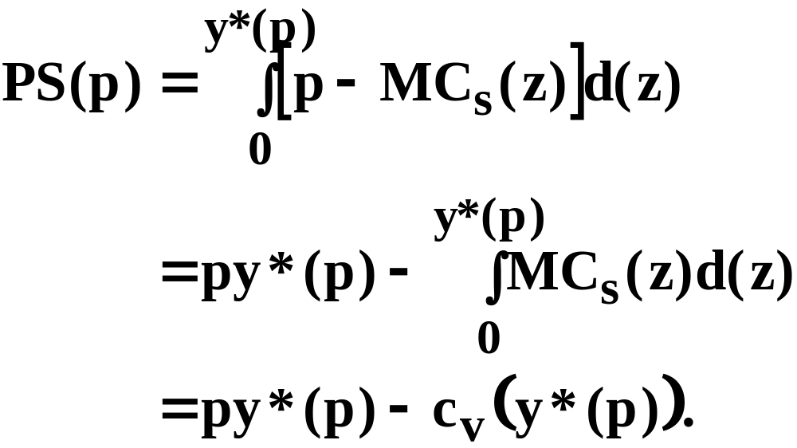
Producer’s Surplus Revisited
So the firm’s producer’s surplus is
That is, PS = Revenue - Variable Cost.

Slide 77
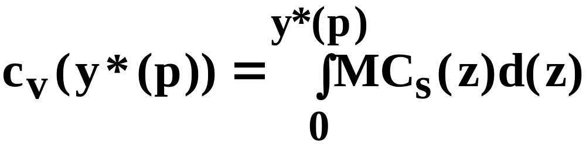
Producer’s Surplus Revisited
$/output unit
MC_{s}(y)
p
AC_{s}(y)
AVC_{s}(y)
y*(p)
y

Slide 78
Producer’s Surplus Revisited
$/output unit
MC_{s}(y)
p
AC_{s}(y)
AVC_{s}(y)
Revenue
= py*(p)
y*(p)
y

Slide 79
Producer’s Surplus Revisited
$/output unit
MC_{s}(y)
p
AC_{s}(y)
AVC_{s}(y)
Revenue
= py*(p)
c_{v}(y*(p))
y*(p)
y

Slide 80
Producer’s Surplus - 1
$/output unit
MC_{s}(y)
p
AC_{s}(y)
AVC_{s}(y)
PS
y*(p)
y

Slide 81
Producer’s Surplus - 2
$/output unit
MC_{s}(y)
p
AC_{s}(y)
AVC_{s}(y)
y*(p)
y

Slide 82
Producer’s Surplus - 3
$/output unit
MC_{s}(y)
p
AC_{s}(y)
AVC_{s}(y)
y*(p)
y

Slide 83
Producer’s Surplus Revisited
PS = Revenue - Variable Cost.
Profit = Revenue - Total Cost
= Revenue - Fixed Cost
- Variable Cost.
So, PS = Profit + Fixed Cost.
Only if fixed cost is zero (the long-run) are PS and profit the same.
Change in PS = change in profits

